Slide 1
Machine Learning INET
Fall 2024

Slide 2
Review
Perceptron, Adaline
Binary Linear classifiers: w^{T}x -> W: weight param, x: feature vector
Threshold function: sign → y^ = sign(W^{T}x)
Range(W^{T}x) in R
Logistic regression: binary linear classifier

Slide 3
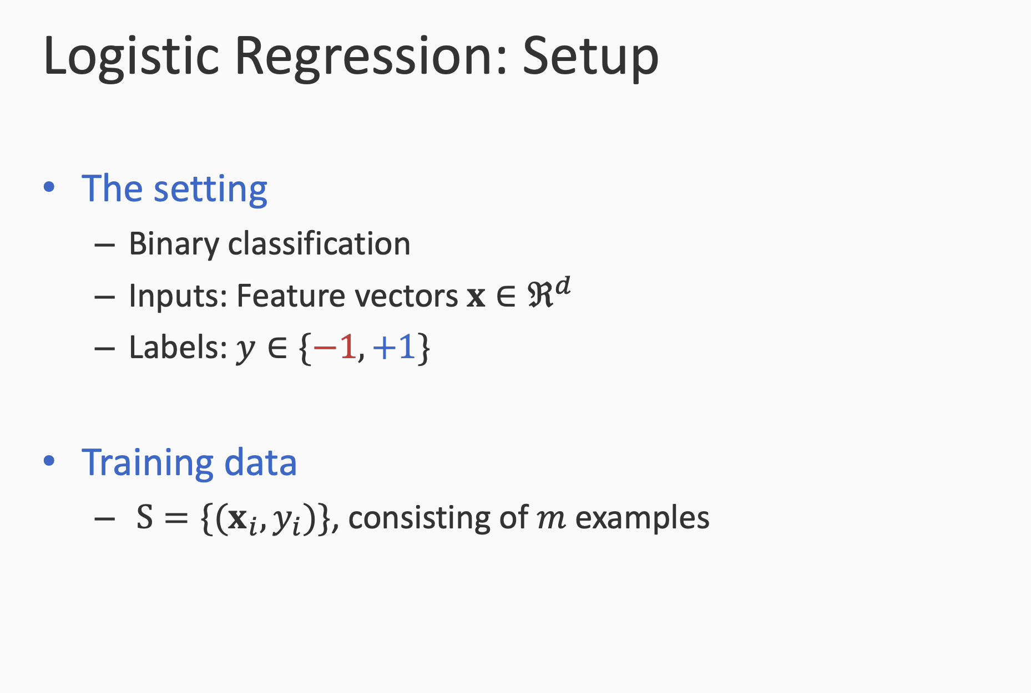

Slide 4
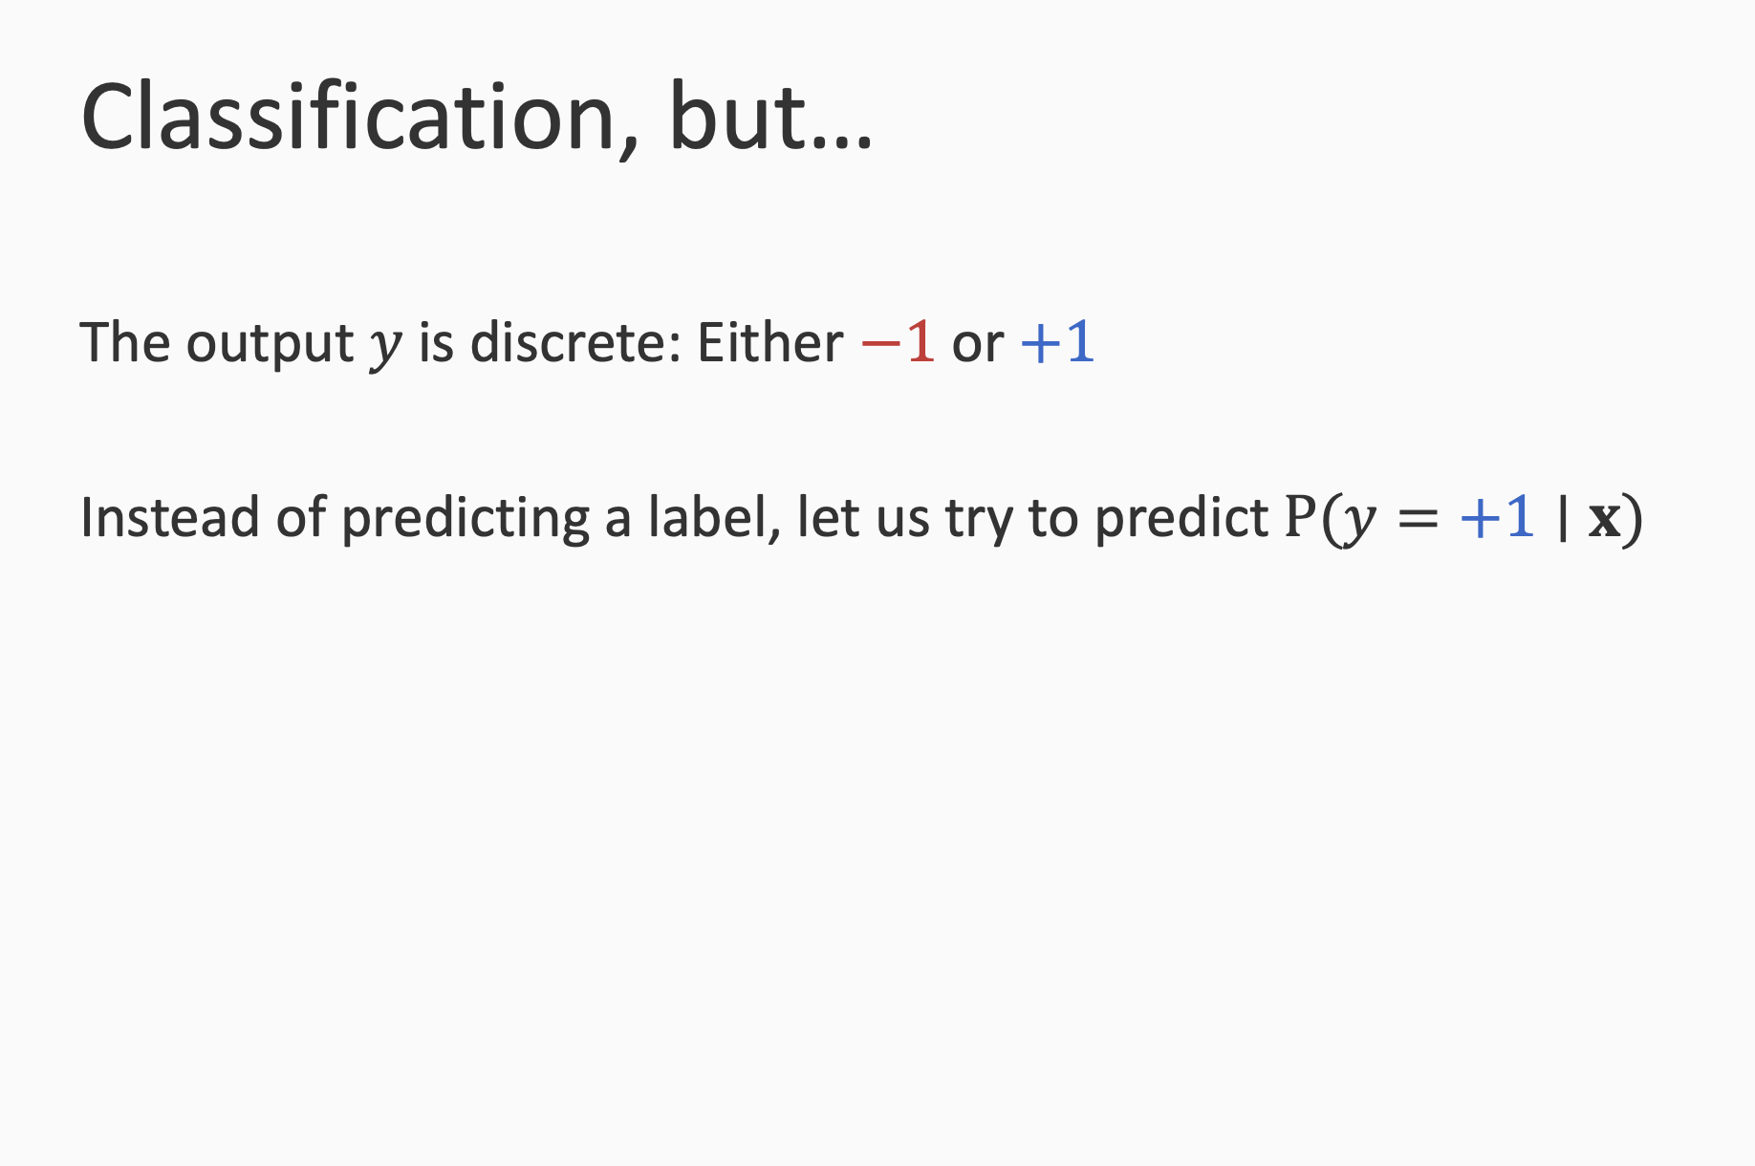

Slide 5
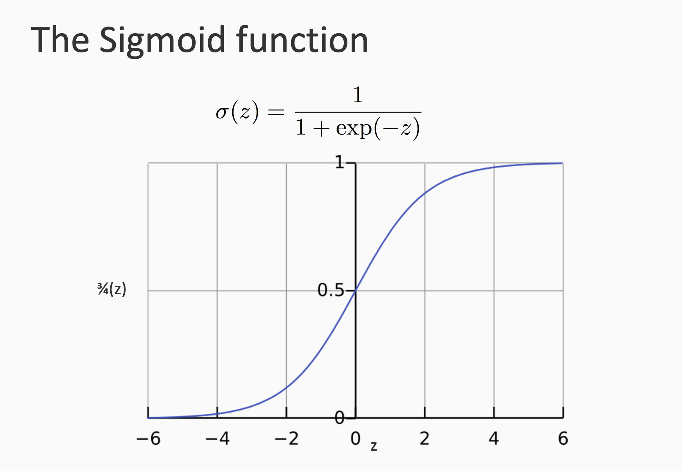

Slide 6
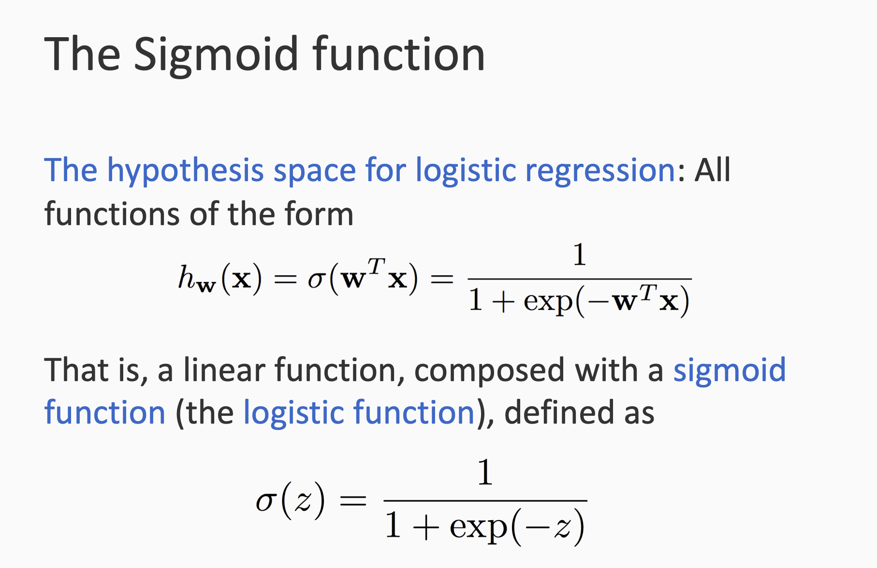

Slide 7
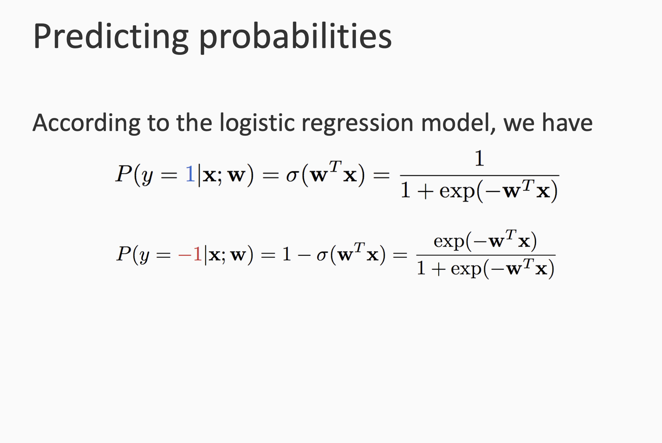

Slide 8
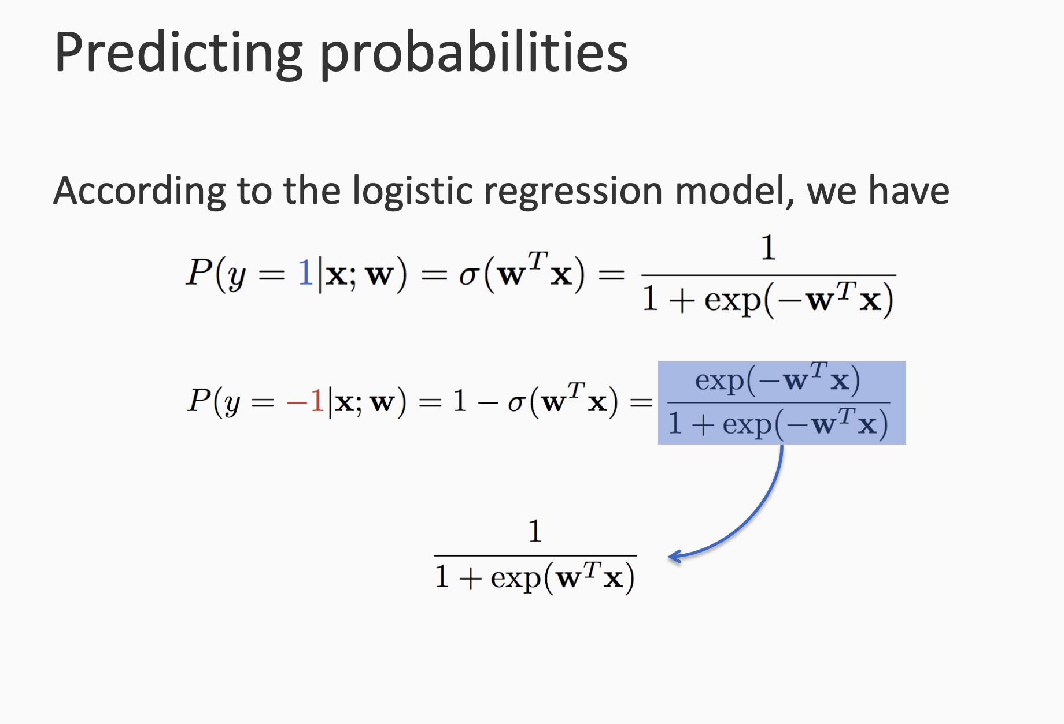

Slide 9
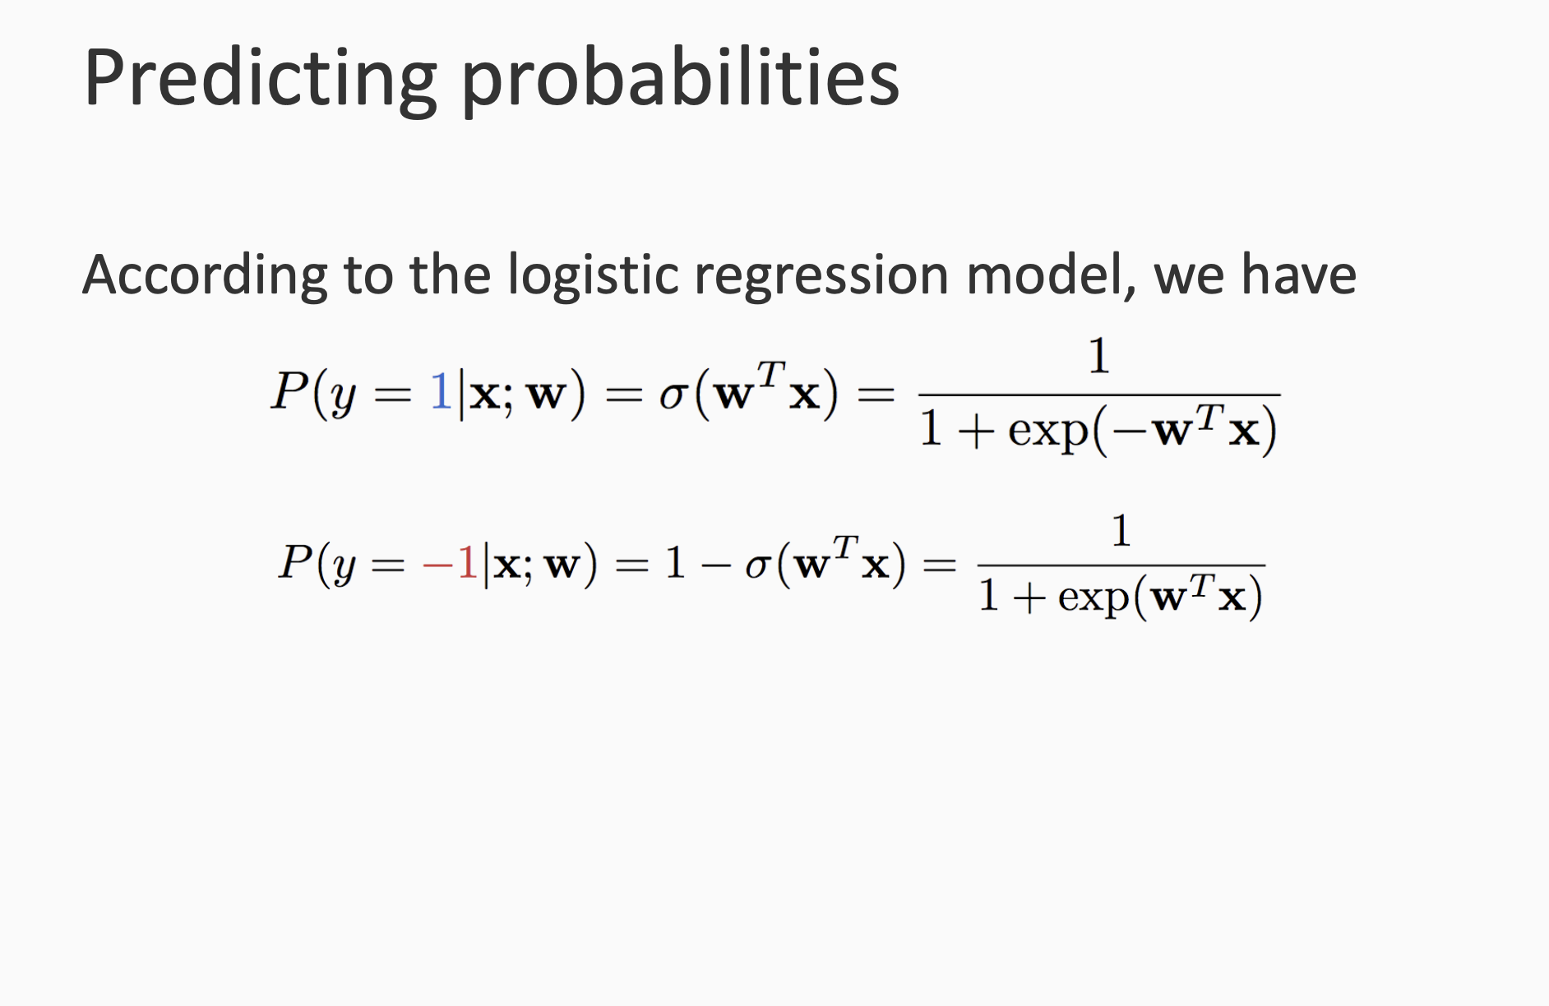

Slide 10
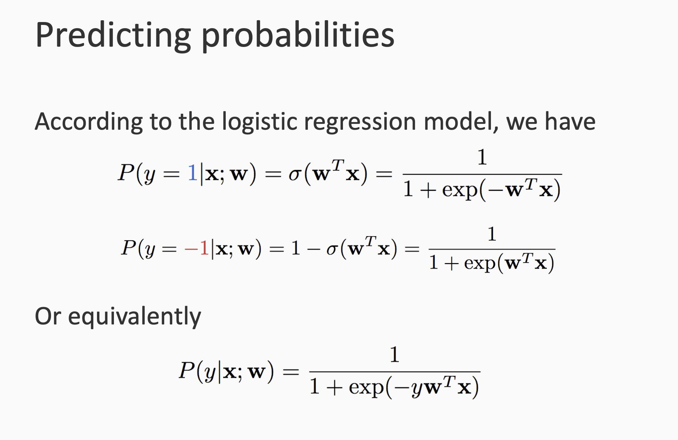

Slide 11
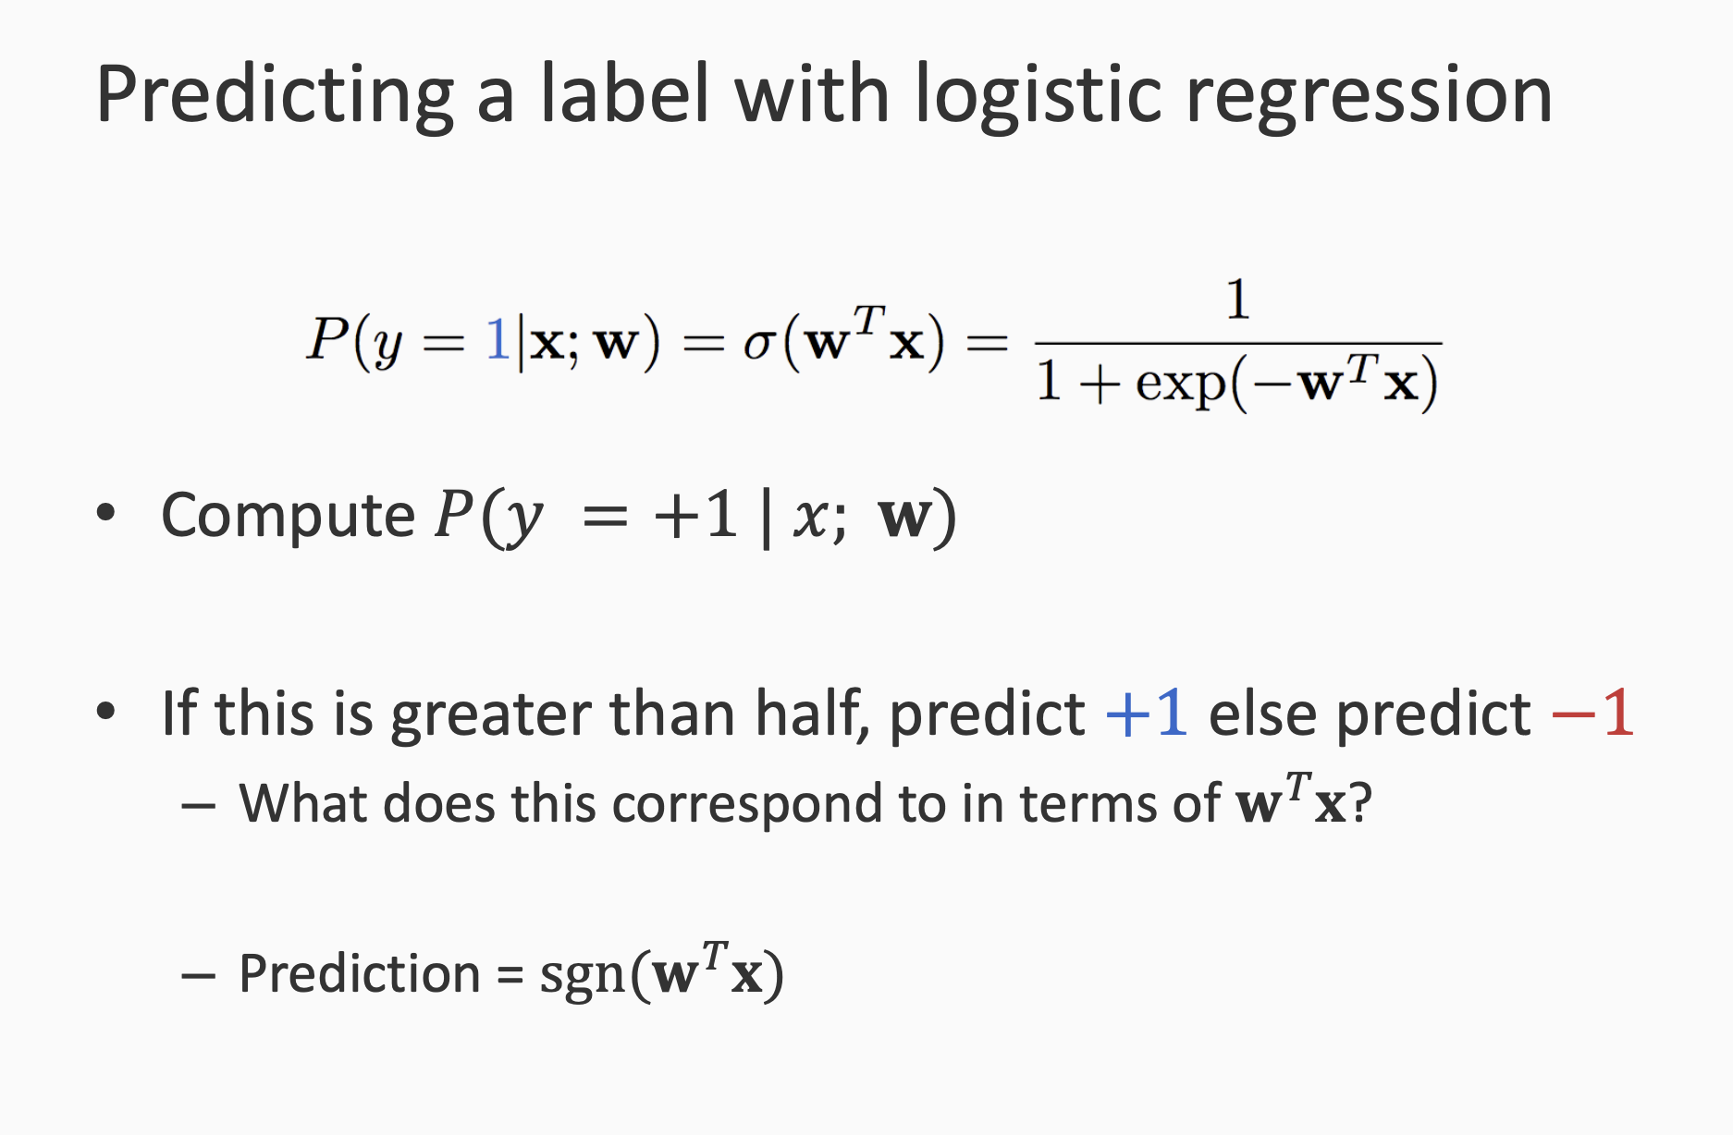

Slide 12
Training Logistic Regression
First: Maximum likelihood estimation (MLE)
Then: Adding priors → Maximum a Posteriori estimation

Slide 13
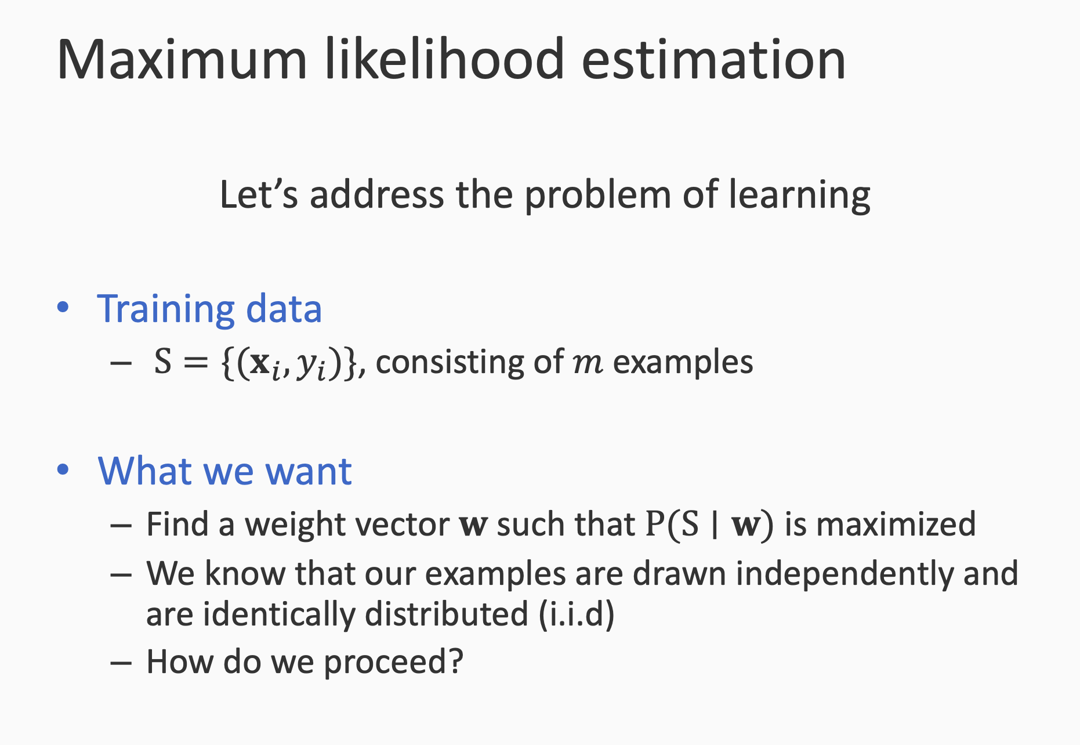

Slide 14
MLE = Maximum Likelihood Estimation
Goal: find parameters W
Given: data S
How: w = argmax P(w|S) = argmax P(S|w). P(w)/P(S) → S is const
w = argmax P(S|w). P(w)
MLE: we assume that w is from a uniform distribution.
P(w) = c
w = argmax P(S|w)
Bayes Rule: P(A|B) = P(B|A). P(A)/P(B)

Slide 15
P(S|w) = P((x1,y1),(x2,y2),...,(xm,ym)|w) → i.i.d assumption
= P((x1,y1)|w) * P((x2,y2)|w) * ....* P((xm,ym)|w)
= P(y1|x1,w) * P(y2|x2,w) * .... * P(ym| xm, w)

Slide 16
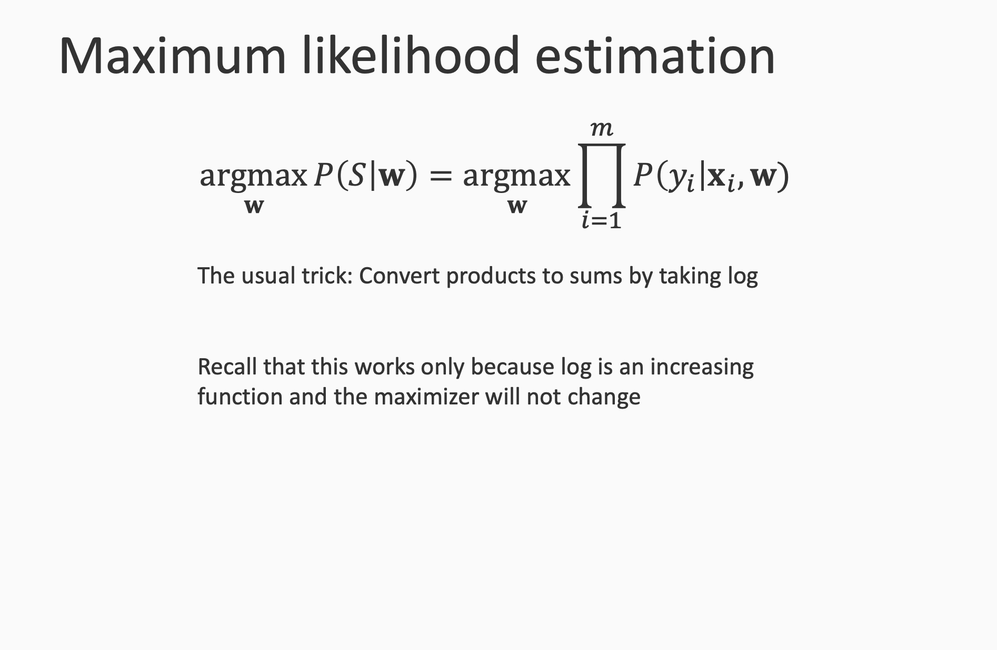

Slide 17
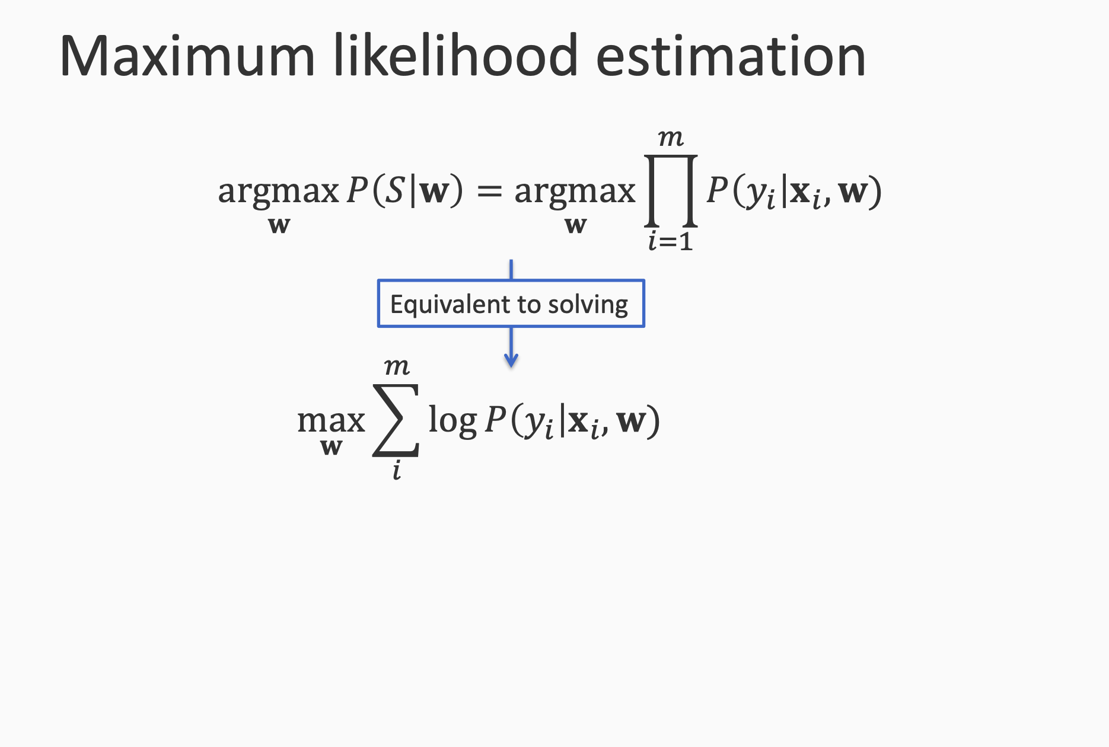

Slide 18
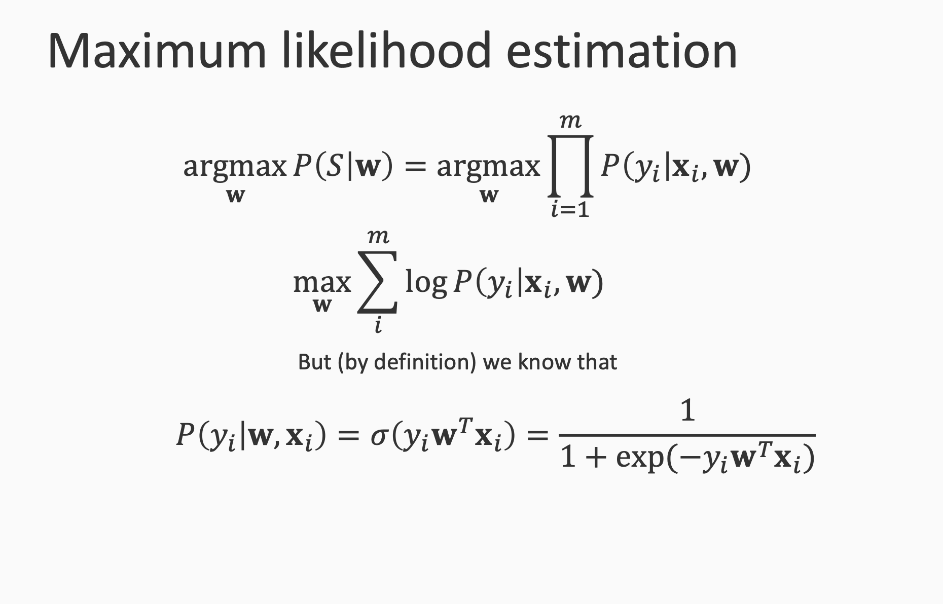

Slide 19
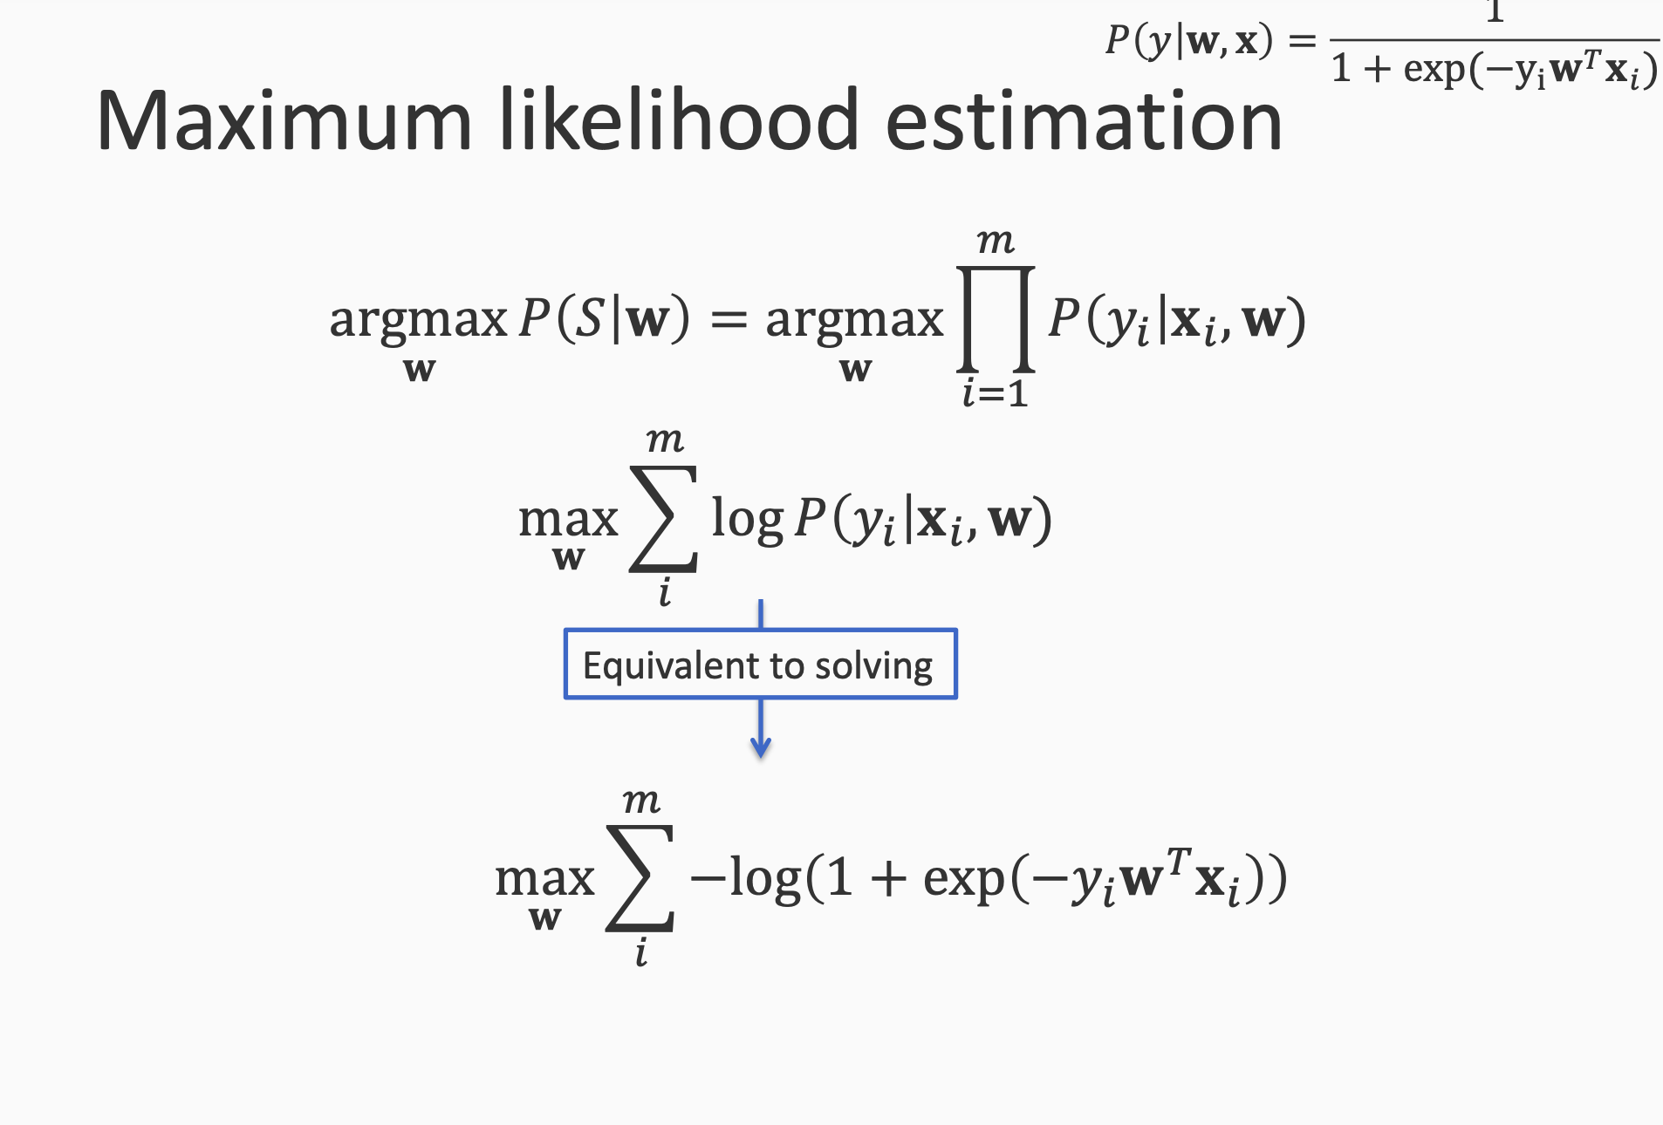

Slide 20
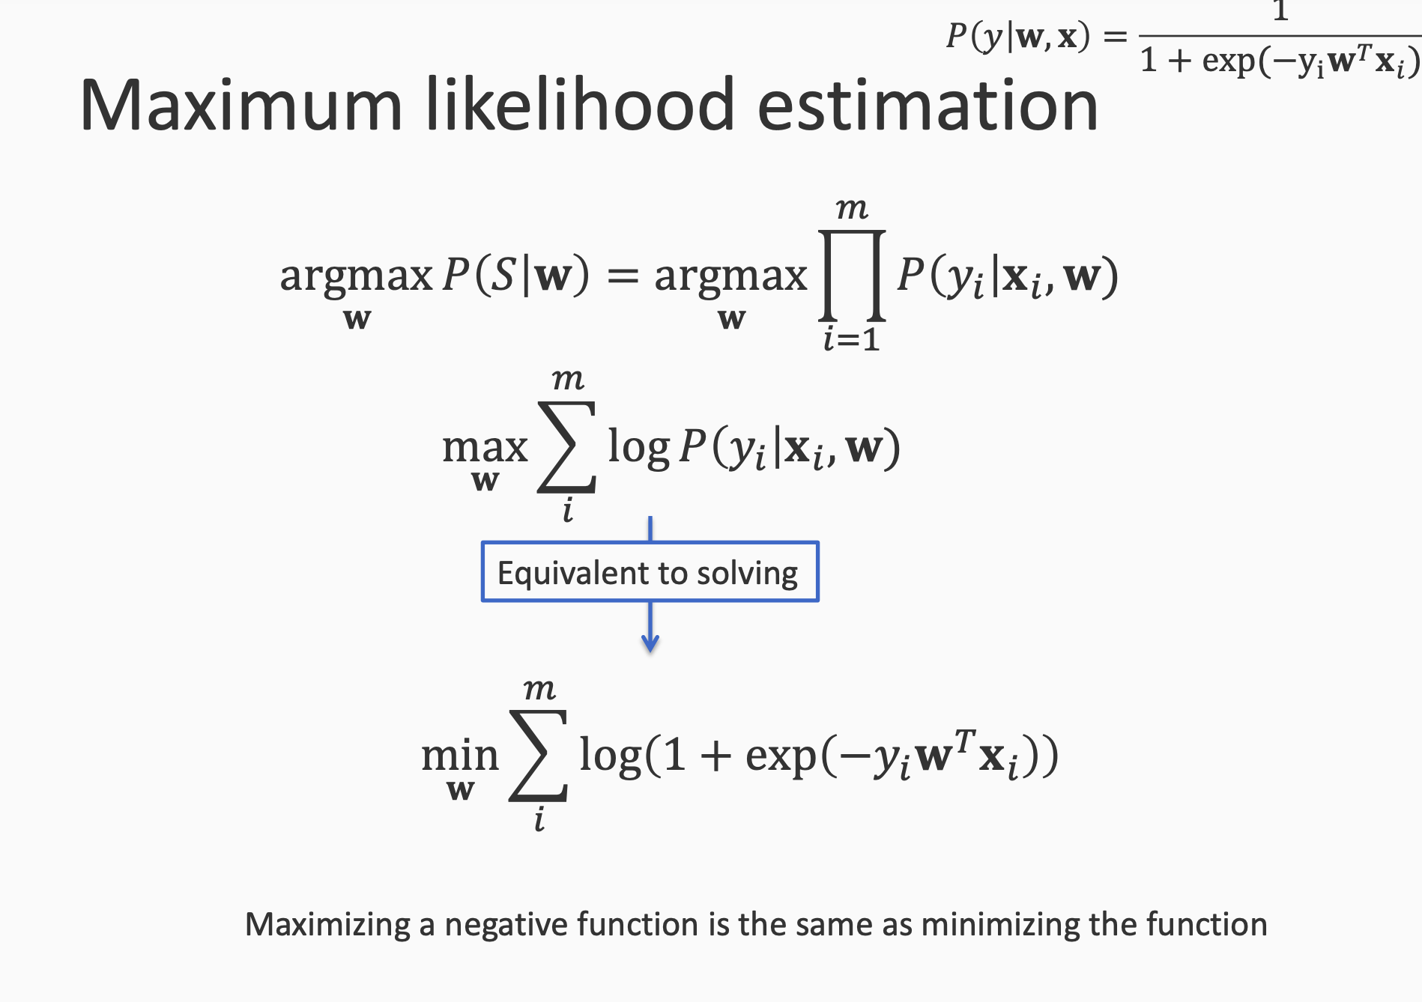

Slide 21
Logistic loss

Slide 22
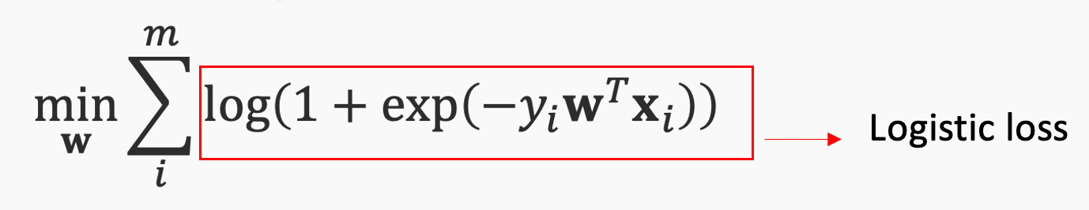
Training logistic regression
Logistic loss:
Train it via GD:
Initialize parameter w to either 0 or a small random number
d = Compute derivative of loss w.r.t w
Update: w = w – r * d

Slide 23
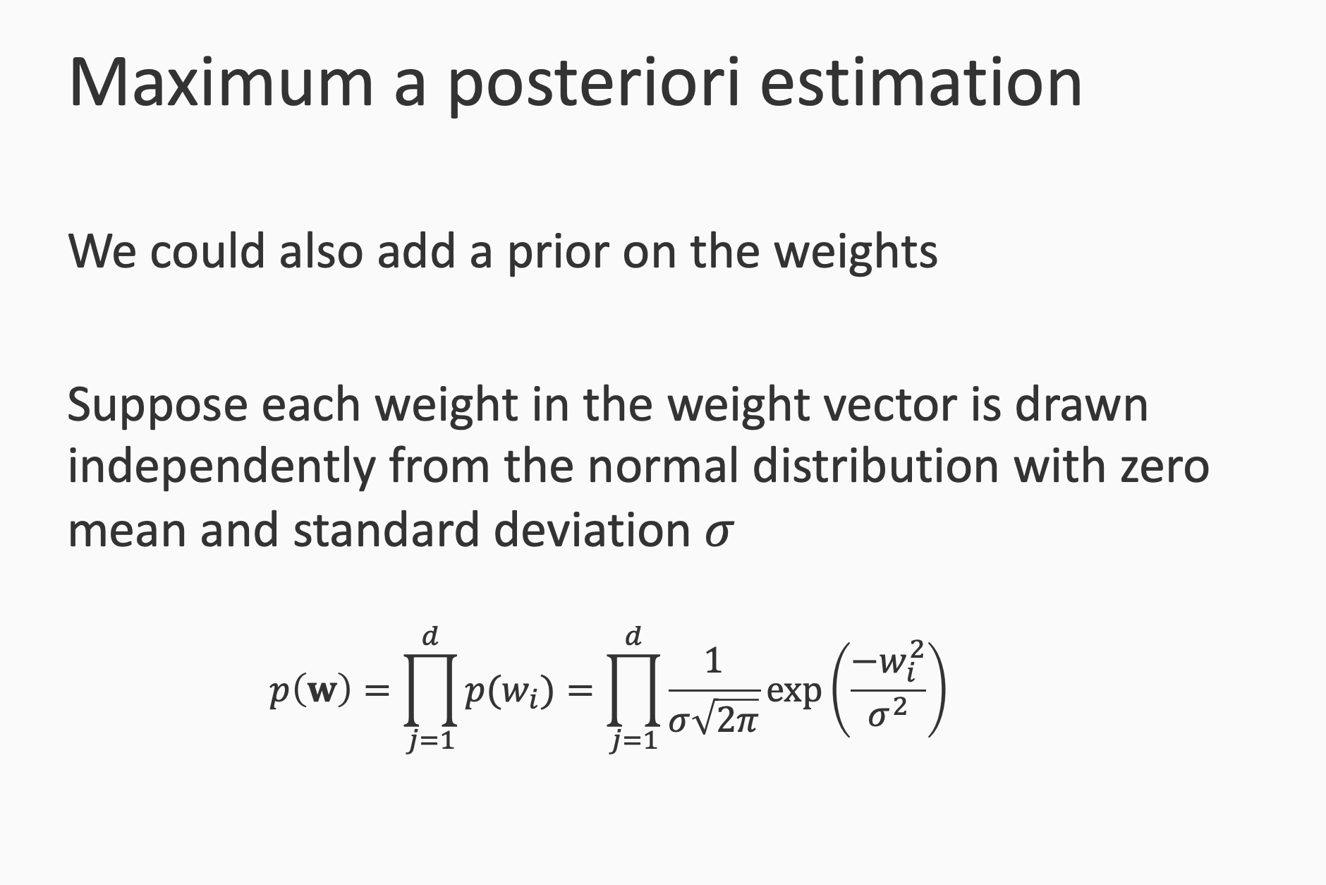

Slide 24
MAP – maximum a posterior estimation
W = argmax P(w|S) = argmax P(S|w).P(w)

Slide 25
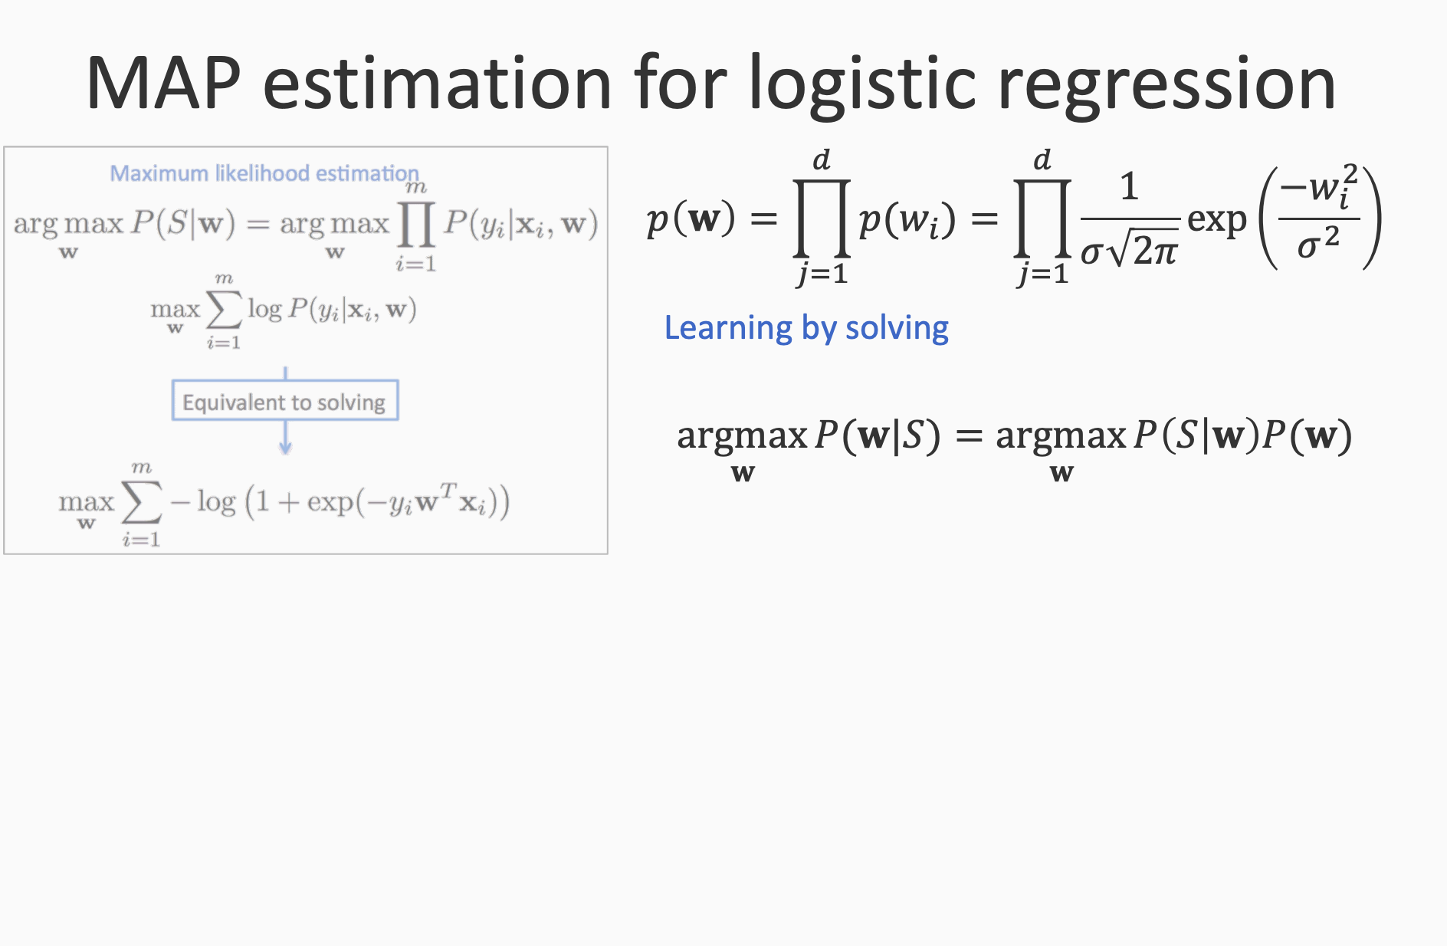

Slide 26
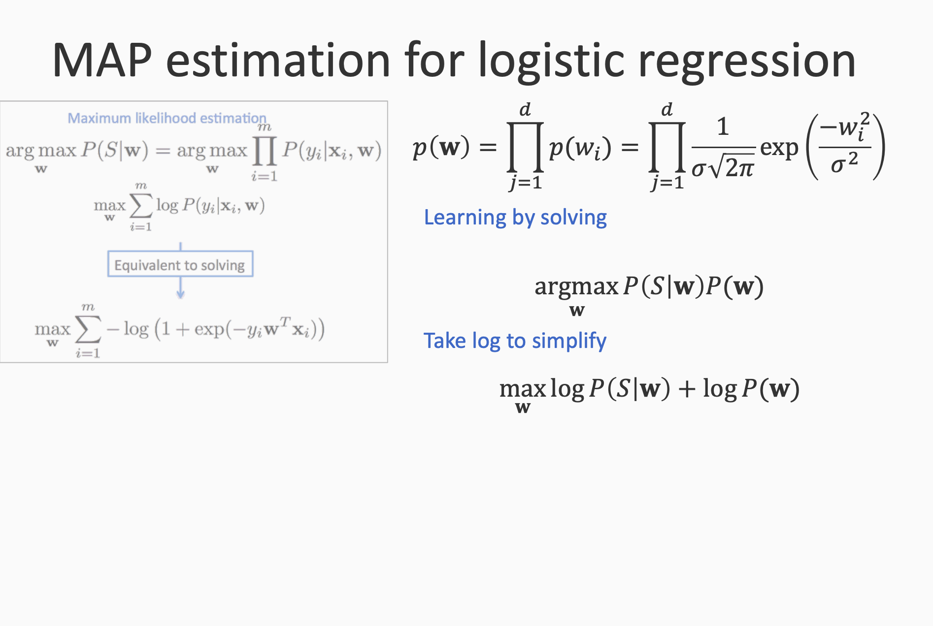

Slide 27
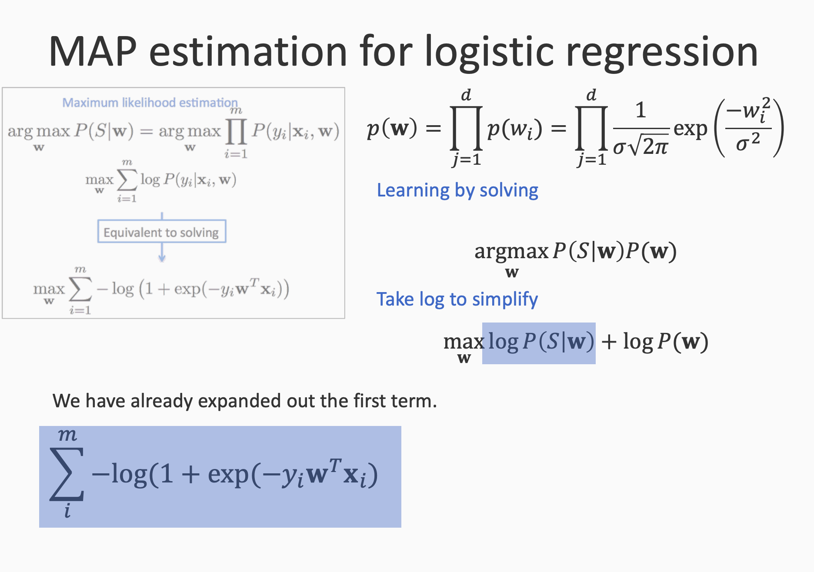

Slide 28
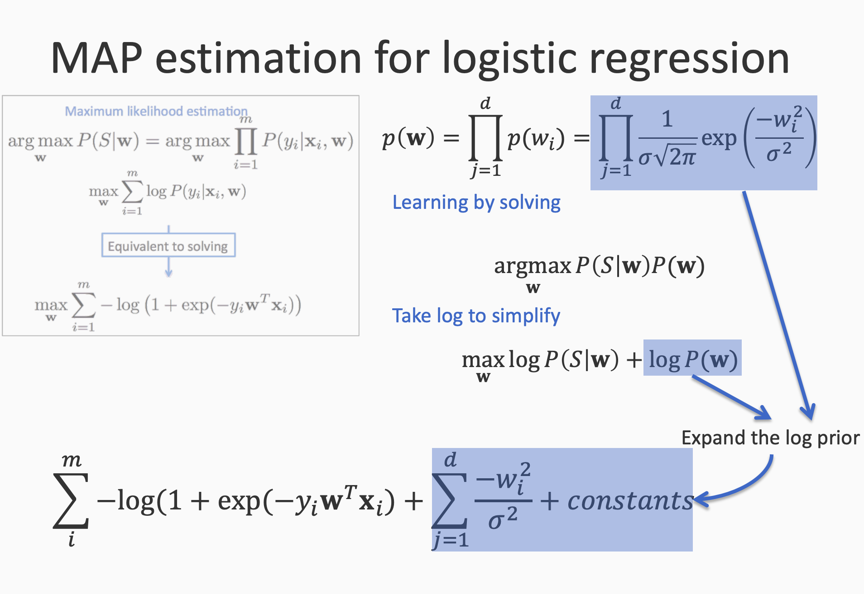

Slide 29
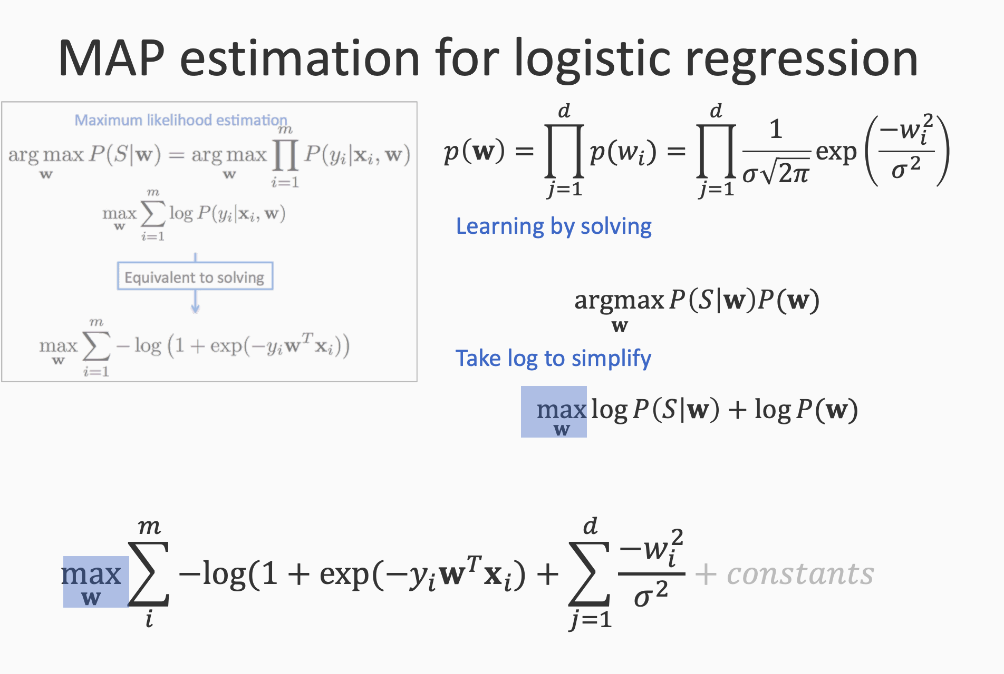

Slide 30
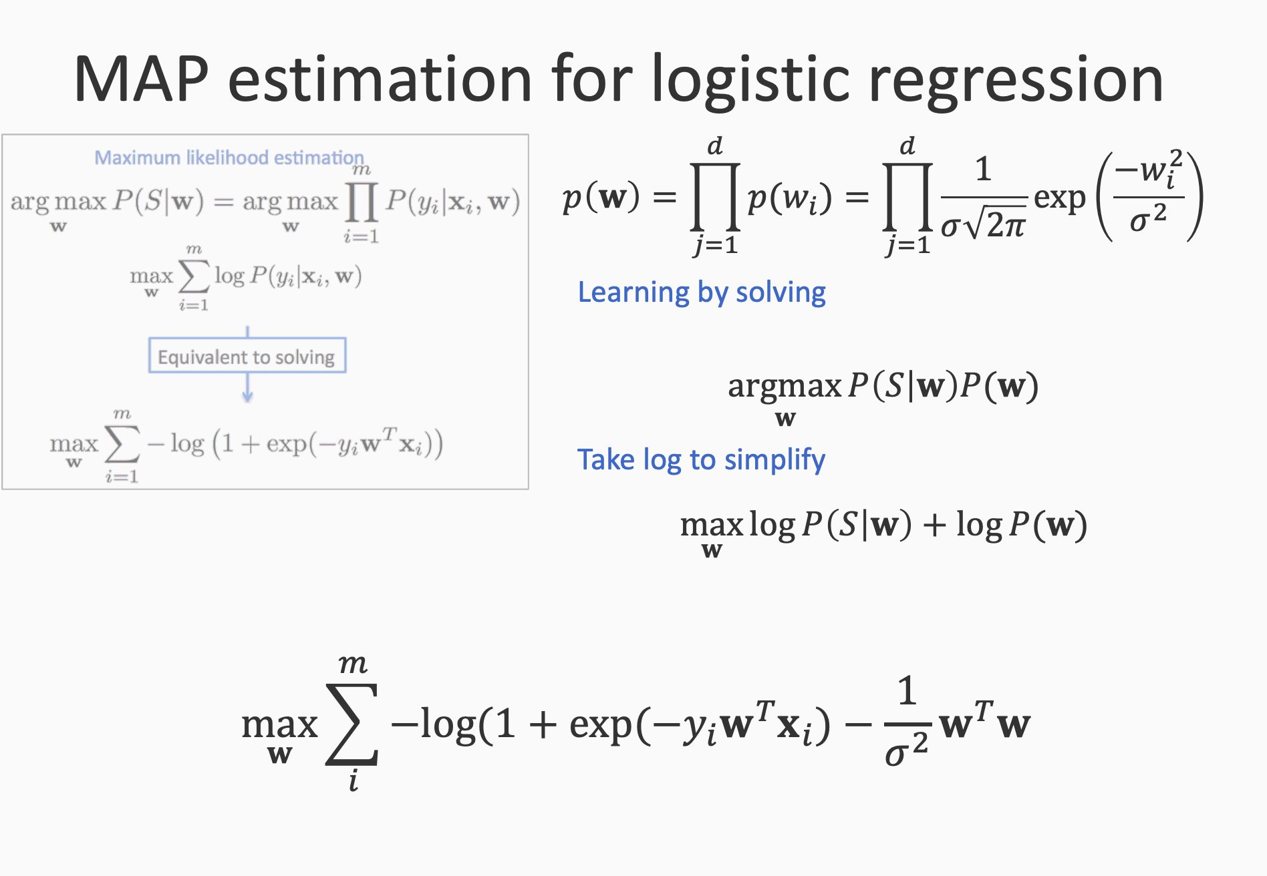

Slide 31
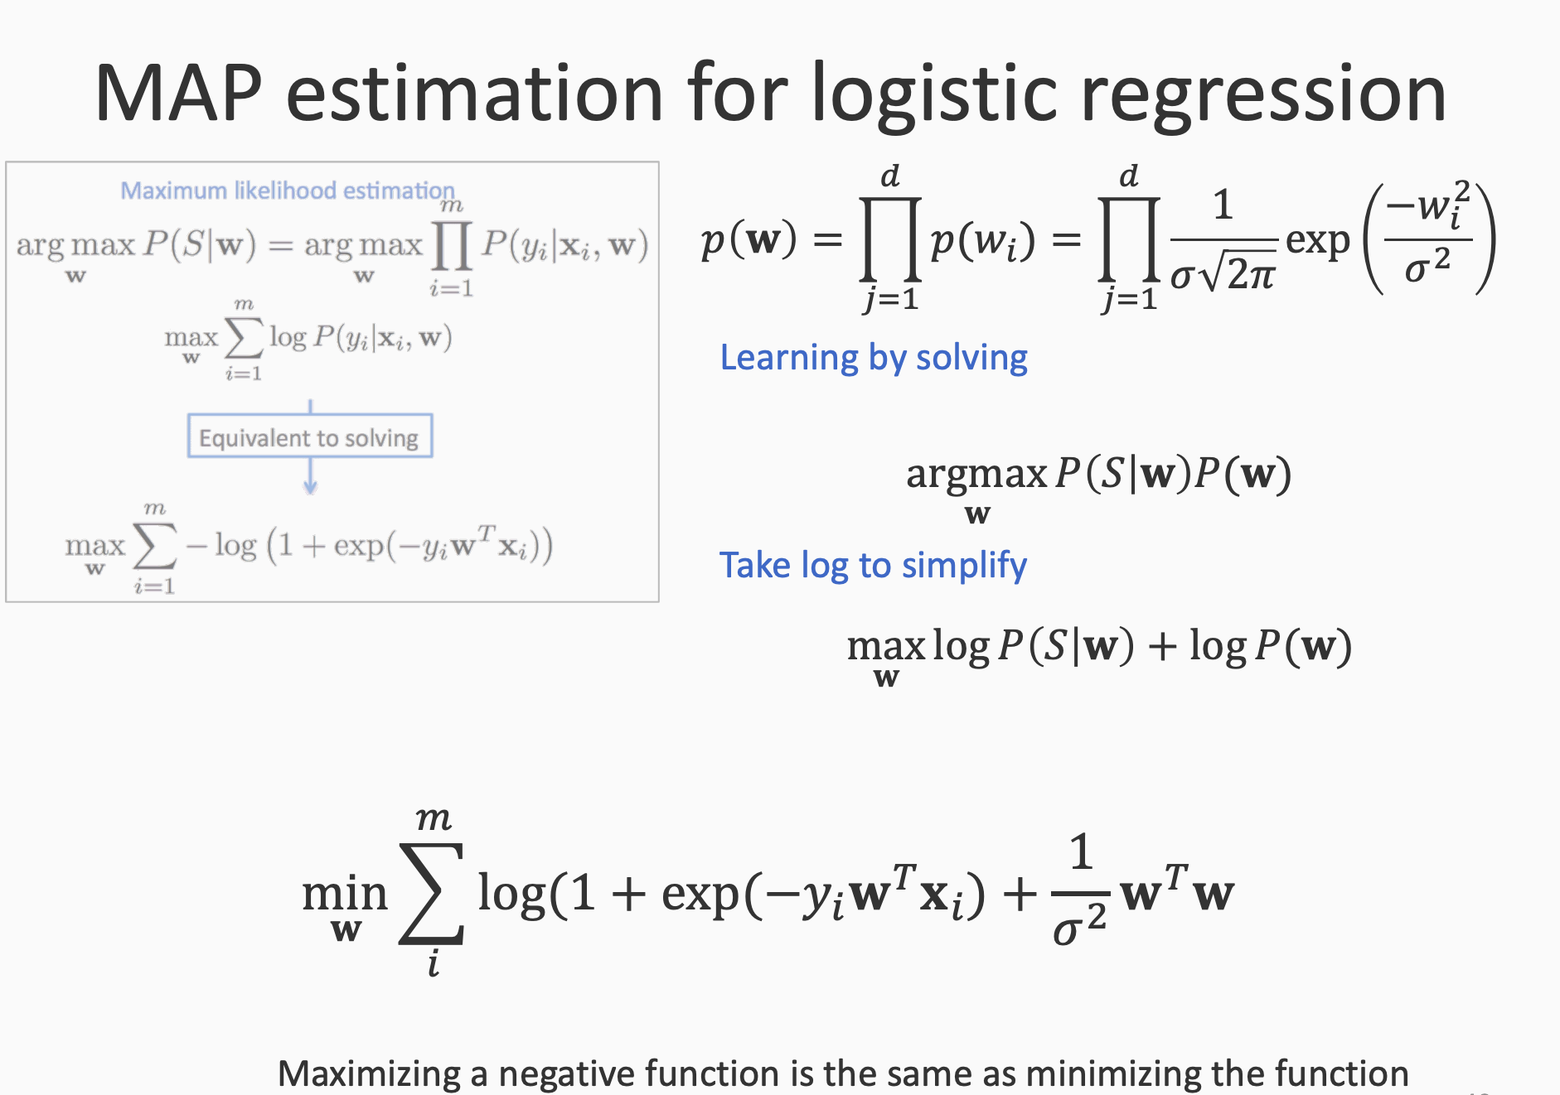

Slide 32
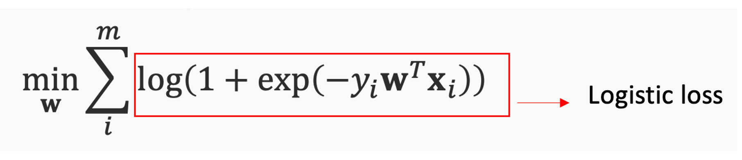
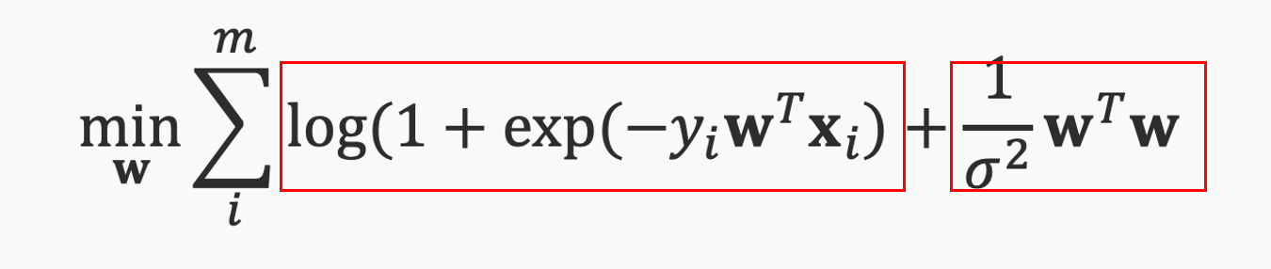
MLE vs MAP
MLE:
MAP:
W^{T}w = |W|²
L2 norm regularizer

Slide 33
Logistic Regression is ...
A classifier that predicts the probability that the label is +1 for a particular input
A classifier that can be trained via MAP or MLE estimation
A classifier that minimizes the logistic loss over the training set

Slide 34
Learning as Loss Minimization

Slide 35
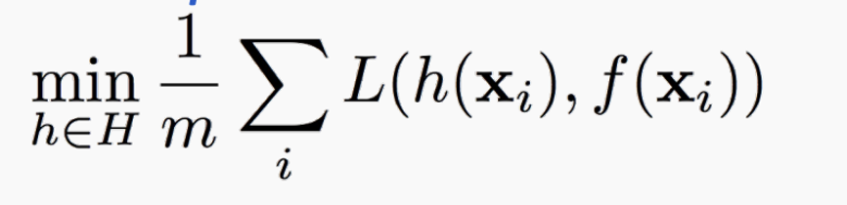
In machine learning: given data points x
We know that x come from a distribution (unknown)
Goal in ML: minimize a loss function on the distribution
Catch: distribution is unknown
Instead of minimizing loss on distribution, minimize on training data
Training data S = {(x,y)}
Empirical loss = minimize the loss on training data

Slide 36
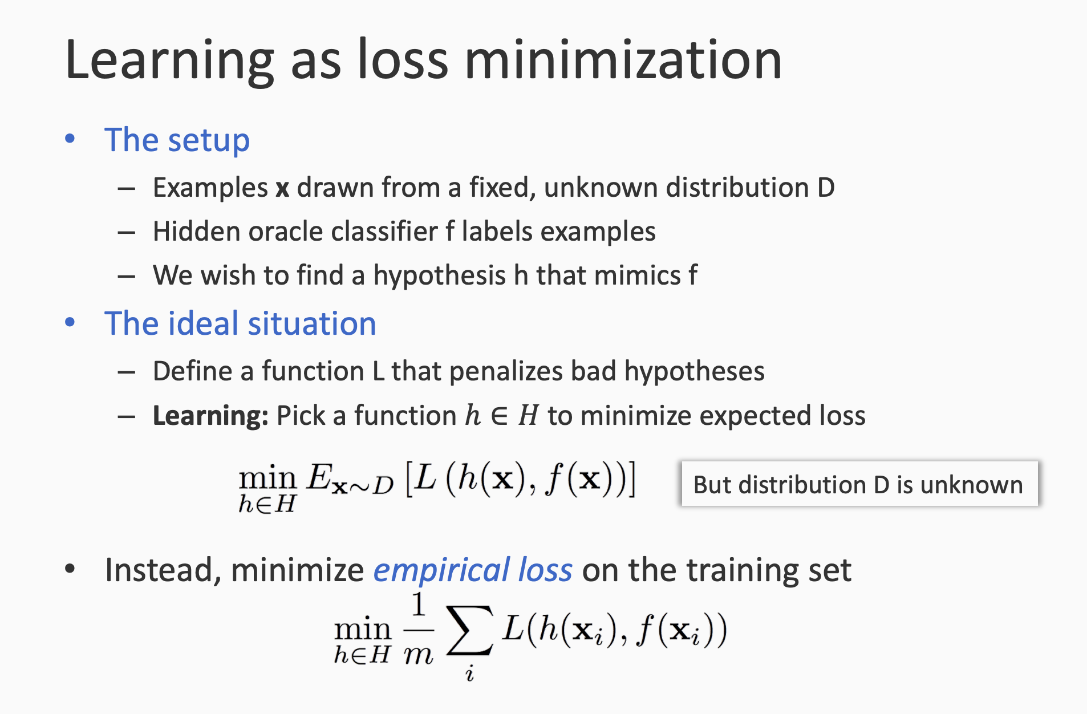

Slide 37
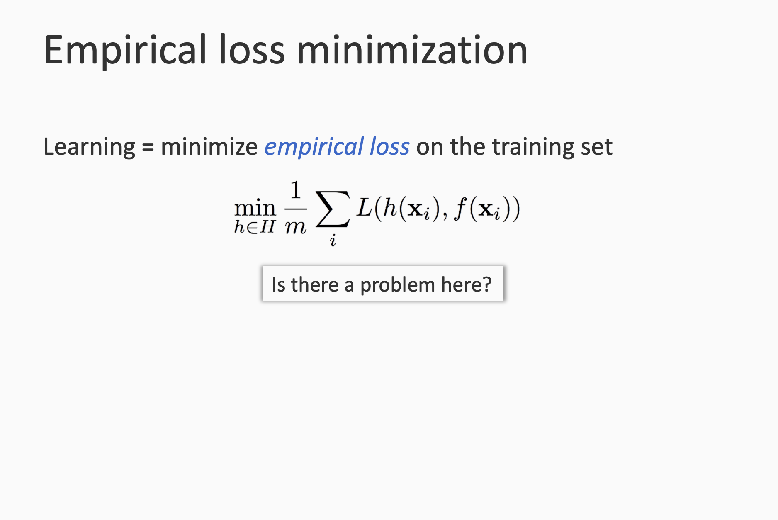

Slide 38
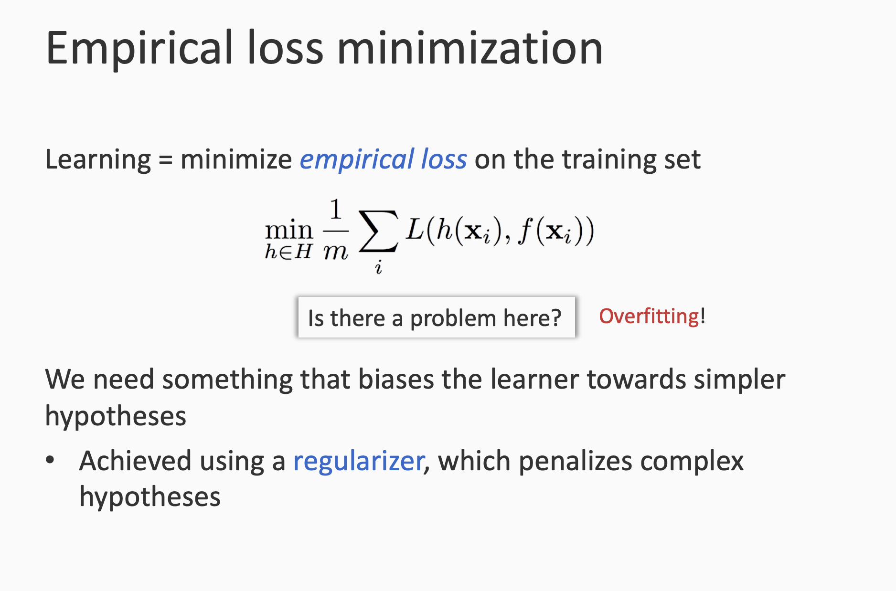

Slide 39
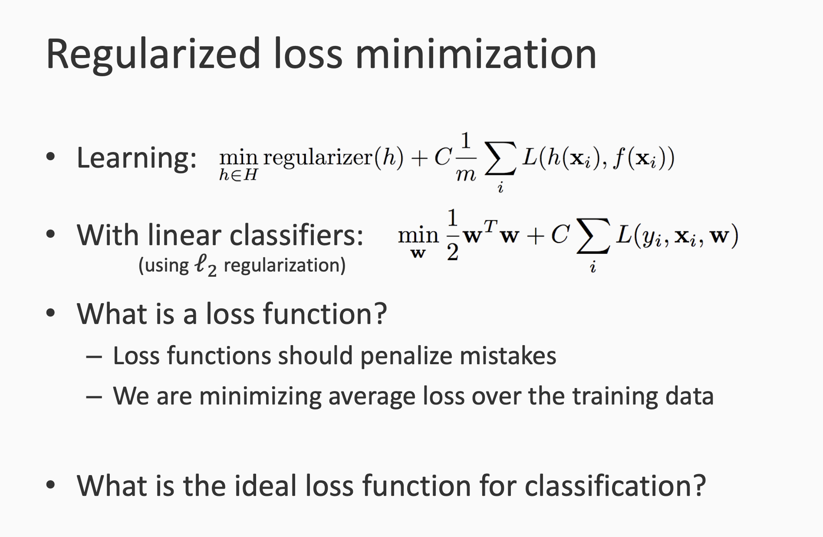

Slide 40
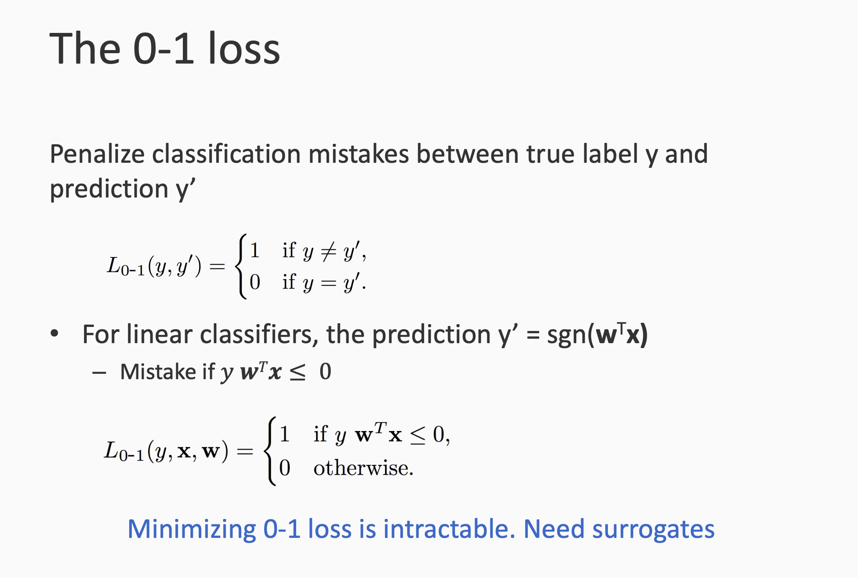

Slide 41
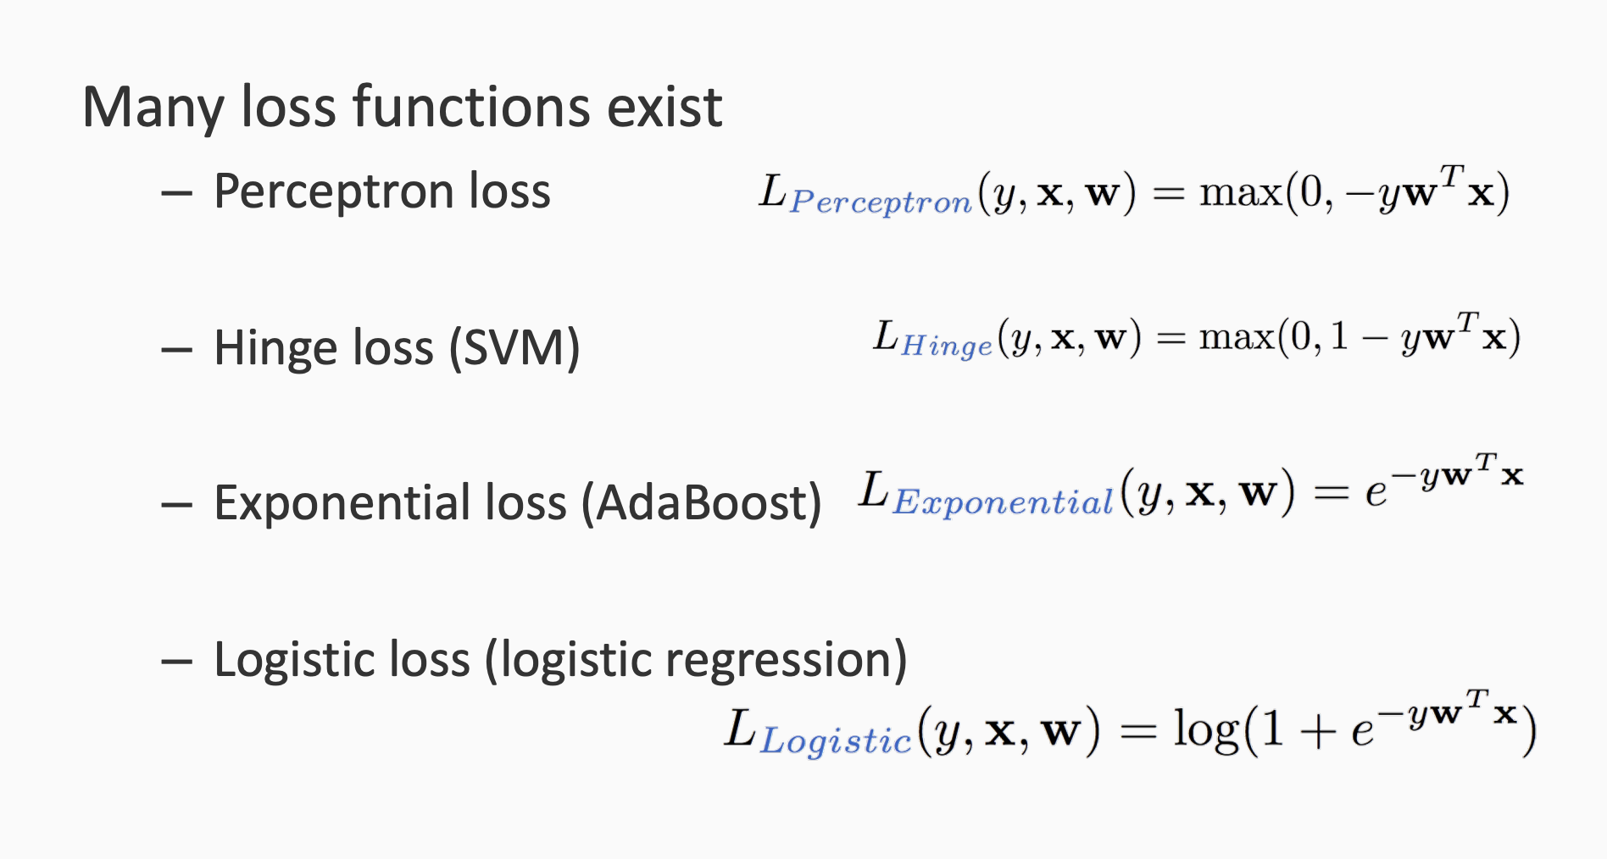
The loss functions

Slide 42
L2 norm regularization: |w|² = w1² + w2² + ... +wd²
L1 norm regularization = |w|1 + |w|2 + ... +|w|d
Elastic net regularization = c.L2 + b.L1
Feature are d-dim
W vector is d-dim
Feature selection as part of model training, use L1 norm

Slide 43
References
https://svivek.com/teaching/lectures/slides/logistic-regression/logistic-regression.pdf

